Slide 1
DASC 5301-002
Logistic Regression
Dr Subharag Sarkar
Fall 2023
Slides Courtesy - Rózsa Záruba

Slide 2
Introduction
Logistic regression is the appropriate regression analysis to conduct when the dependent variable is dichotomous (binary).
Like all regression analyses, logistic regression is a predictive analysis.
Logistic regression is used to describe data and to explain the relationship between one dependent binary variable and one or more nominal, ordinal, interval or ratio-level independent variables.
Notes:
After 1st point-> It is used when our dependent variable is dichotomous or binary. It just means a variable that has only 2 outputs, for example, A person will survive this accident or not, The student will pass this exam or not. The outcome can either be yes or no (2 outputs).
After last point-> This regression technique is similar to linear regression and can be used to predict the Probabilities for classification problems.

Slide 3
Why is it called Logistic Regression?
Logistic regression is called logistic regression because it uses a logistic function to transform the output of the linear function into a probability value.
The logistic function is a non-linear function that is shaped like an S-curve.
It has a range of 0 to 1, which makes it ideal for modeling probabilities

Slide 4
History of Logistic Regression
Logistic Regression is part of a larger class of algorithms known as Generalized Linear Model (GLM).
In 1972, Nelder and Wedderburn proposed this model with an effort to provide a means of using linear regression to the problems which were not directly suited for application of linear regression.
In fact, they proposed a class of different models (linear regression, ANOVA, Poisson Regression etc) which included logistic regression as a special case.

Slide 5
Types of Logistic Regression
Binary logistic regression
Binary logistic regression is used to predict the probability of a binary outcome, such as yes or no, true or false, or 0 or 1.
For example, it could be used to predict whether a customer will churn or not, whether a patient has a disease or not, or whether a loan will be repaid or not.

Slide 6
Types of Logistic Regression
Multinomial logistic regression
Multinomial logistic regression is used to predict the probability of one of three or more possible outcomes, such as the type of product a customer will buy, the rating a customer will give a product, or the political party a person will vote for.

Slide 7
Types of Logistic Regression
Ordinal logistic regression
It is used to predict the probability of an outcome that falls into a predetermined order, such as the level of customer satisfaction, the severity of a disease, or the stage of cancer.

Slide 8
Why use Logistic Regression rather than Linear Regression

Slide 9
Linear Regression vs Logistic Regression
From the definition of logistic regression we now know that it is only used when our dependent variable is binary and in linear regression this dependent variable is continuous.
We have also observed that when outlier is added in our dataset, the best fit line in linear regression shifts to fit that point.
Let us look at an example what happens when linear regression is used.

Slide 10
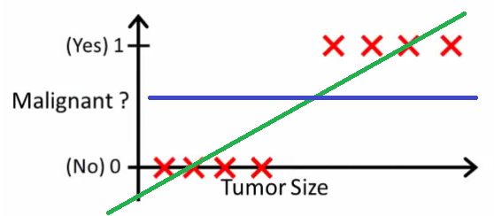
Linear Regression vs Logistic Regression
Here the threshold value is 0.5, which means if the value of h(x) is greater than 0.5 then we predict malignant tumor (1) and if it is less than 0.5 then we predict benign tumor (0).
Everything seems okay here but now let’s change it by adding some outliers in our dataset.
This will cause the best fit line to shift.
Notes:
Start-> The graph shown here shows a dataset which classifies if the data corresponds to malignant tumor or benign tumor.

Slide 11
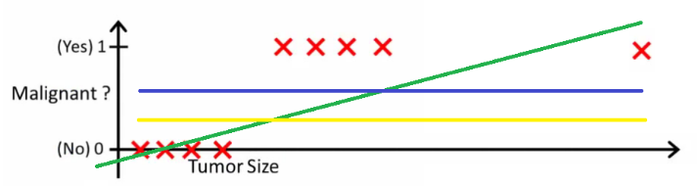
Linear Regression vs Logistic Regression
Hence the line will be somewhat like this:
The blue line represents the old threshold and the yellow line represents the new threshold which is maybe 0.2 here.
To keep our predictions right we had to lower our threshold value.
Hence, we can say that linear regression result is prone to outliers.
Now here if h(x) is greater than 0.2 then only this regression will give correct outputs.
Notes:
Start-> The graph shown here shows a dataset which classifies if the data corresponds to malignant tumor or benign tumor.

Slide 12
Linear Regression vs Logistic Regression
Another problem with linear regression is that the predicted values may be out of range.
We know that probability can be between 0 and 1, but if we use linear regression this probability may exceed 1 or go below 0.
To overcome these problems we use Logistic Regression, which converts this straight best fit line in linear regression to an S-curve using the sigmoid function, which will always give values between 0 and 1.

Slide 13
Linear Regression vs Logistic Regression
Linear Regression | Logistic Regression
It is used to predict the continuous dependent variable using a given set of independent variables. | It is used to predict categorical dependent variable using a given set of independent variables.
It is used to solve Regression problem | It is used to solve Classification Problems
It is used to predict value of continuous variables. | It is used to predict values of categorical variables.
In Linear Regression, we find the best fit line, by which we can easily predict the output. | In Logistic Regression, we find the S-curve by which we can classify the samples.

Slide 14
Linear Regression vs Logistic Regression
Linear Regression | Logistic Regression
Least Square estimation method is used for estimation of accuracy. | Maximum Likelihood estimation method is used for estimation of accuracy.
The output must be a continuous value such as price, age, etc. | The output of Logistic Regression must be a Categorical value such as 0 or 1, Yes or No, etc.
In Linear Regression, it is required that relationship between dependent variable and independent variable must be linear. | In Logistic Regression, it is not required to have the linear relationship between the dependent and independent variable.
In Linear Regression, there may be collinearity between the independent variables. | In Logistic Regression, there should not be collinearity between the independent variable.

Slide 15
Assumptions of Logistic Regression

Slide 16
Assumptions for Logistic Regression
The dependent variable must be categorical in nature.
The independent variable should not have multi-collinearity.
GLM does not assume a linear relationship between dependent and independent variables.
However, it assumes a linear relationship between link function and independent variables in logit model.

Slide 17
Assumptions for Logistic Regression
The dependent variable need not to be normally distributed.
It does not use OLS (Ordinary Least Square) for parameter estimation.
Instead, it uses maximum likelihood estimation (MLE).
Errors need to be independent but not normally distributed.

Slide 18
Logistic Function (Sigmoid Function)
The sigmoid function is a mathematical function used to map the predicted values to probabilities.
It maps any real value into another value within a range of 0 and 1.
The value of the logistic regression must be between 0 and 1, which cannot go beyond this limit, so it forms a curve like the "S" form. The S-form curve is called the Sigmoid function or the logistic function.
In logistic regression, we use the concept of the threshold value, which defines the probability of either 0 or 1.
Such as values above the threshold value tends to 1, and a value below the threshold values tends to 0.

Slide 19
How does Logistic Regression work?

Slide 20
Steps of Logistic Regression
Logistic regression works in the following steps:
Prepare the data: The data should be in a format where each row represents a single observation and each column represents a different feature. The target variable (the variable you want to predict) should be binary (yes/no, true/false, 0/1).
Train the model: We teach the model by showing it the training data. This involves finding the values of the model parameters that minimize the error in the training data.

Slide 21
Steps of Logistic Regression
Logistic regression works in the following steps:
Evaluate the model: The model is evaluated on the held-out test data to assess its performance on unseen data.
Use the model to make predictions: After the model has been trained and assessed, it can be used to forecast outcomes on new data.

Slide 22
Maths of Logistic Regression

Slide 23
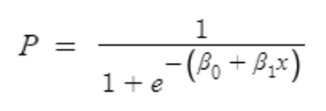
Maths of Logistic Regression
The next natural question which comes to mind, is how to convert the result of Linear Regression into a probability where the values will be between 0 and 1.
In the next few slides, we will look into the maths which makes it possible.
The formula of Logistic Function that needs to be solved is:
Notes:
After the last point.
We will how we can get this formula from the Linear regression equation.

Slide 24

Maths of Logistic Regression
We all know the equation of the best fit line in linear regression is:
For Logistic Regression, instead of y we have calculate the probabilities (P).
The issue is that if we use this equation, the value of P will exceed 1 or go below 0.
That is unacceptable since probability needs to be between 0 and 1.

Slide 25

Maths of Logistic Regression
To overcome this issue, we take “odds” of P:
We know that odds can always be positive which means the range will always be (0,+∞ ).
Odds are nothing but the ratio of the probability of success and probability of failure.
Now the question comes out of so many other options to transform this why did we only take ‘odds’?
Because odds are probably the easiest way to do this, that’s it.

Slide 26
Maths of Logistic Regression
Now using “odds” poses another problem.
The range is restricted, and we don’t want a restricted range because if we do so then our correlation will decrease.
By restricting the range, we are actually decreasing the number of data points and of course, if we decrease our data points, our correlation will decrease.

Slide 27

Maths of Logistic Regression
It is difficult to model a variable that has a restricted range.
To control this, we take the log of odds or logits which has a range from (-∞,+∞).
Now we just want a function of P because we want to predict probability, right? not log of odds.
To do so we will multiply by exponent on both sides and then solve for P.

Slide 28
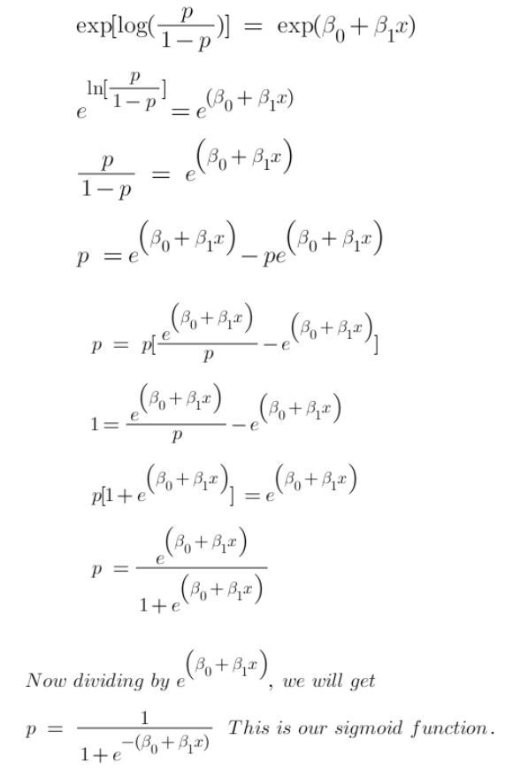

Slide 29
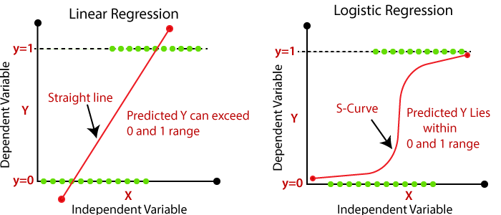
Maths of Logistic Regression
Now we have our logistic function, also called a sigmoid function.
The graph of a sigmoid function is shown
It squeezes a straight line into an S - curve

Slide 30
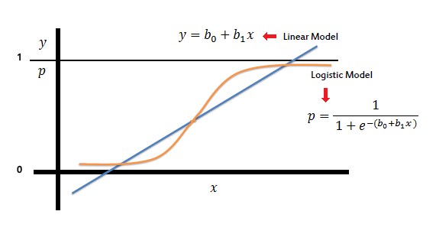
Maths of Logistic Regression
The coefficient (b₁) is the amount the logit (log-odds) changes with a one unit change in x.

Slide 31
Cost Function in Logistic Regression

Slide 32
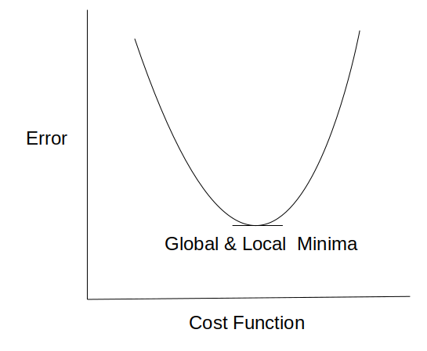
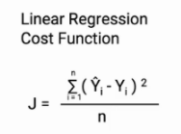
Cost Function in Logistic Regression
In linear regression, we use the Mean squared error which was the difference between y_predicted and y_actual and this is derived from the maximum likelihood estimator.
The graph of the cost function in linear regression is like this:

Slide 33
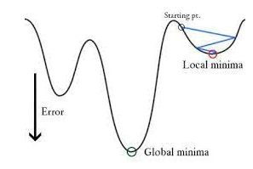
Cost Function in Logistic Regression
In logistic regression Yi is a non-linear function (Ŷ=1​/1+ e^{-z}).
If we use this in the above MSE equation, then it will give a non-convex graph with many local minima as shown:

Slide 34

Cost Function in Logistic Regression
The problem here is that this cost function will give results with local minima, which is a big problem because then we’ll miss out on our global minima and our error will increase.
In order to solve this problem, we derive a different cost function for logistic regression called log loss which is also derived from the maximum likelihood estimation method.

Slide 35
Use of Maximum Likelihood Estimator
The main aim of MLE is to find the value of our parameters for which the likelihood function is maximized.
The likelihood function is nothing but a joint pdf of our sample observations.
In other words, we try to find such that plugging these estimates into the model for P(x), yields a number close to one for people who had a malignant tumor and close to 0 for people who had a benign tumor.
Notes:
After 2nd point and joint distribution is the multiplication of the conditional probability for observing each example given the distribution parameters.

Slide 36
Pros and Cons
Cons:
The assumption of linearity in the logit can rarely hold
Uncertainty in Feature importance.
Not robust to big-influentials
Pros:
Simplicity and transparency
Giving probabilistic output
Feature importance and direction

Slide 37
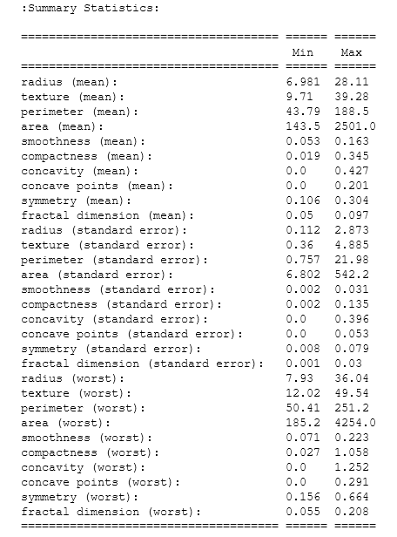
Example
Breast cancer wisconsin (diagnostic) dataset
**Data Set Characteristics:** :
Number of Instances: 569 :
Number of Attributes: 30 numeric, predictive attributes and the class
Attribute Information:
- radius (mean of distances from center to points on the perimeter)
- texture (standard deviation of gray-scale values) – perimeter
- area
- smoothness (local variation in radius lengths)
- compactness (perimeter^2 / area - 1.0)
- concavity (severity of concave portions of the contour)
- concave points (number of concave portions of the contour)
- symmetry
fractal dimension ("coastline approximation“ )
Class:
WDBC-Malignant
WDBC-Benign
Class Distribution: 212 - Malignant, 357 - Benign

Slide 38
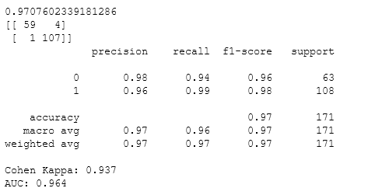
Results
Logistic Regression
0- Malignant
1- Benign

Slide 39
References
https://www.analyticsvidhya.com/blog/2021/08/conceptual-understanding-of-logistic-regression-for-data-science-beginners/

